Slide 1
Angular 2
Component basics
and templates

Slide 2
Angular module
Angular apps are modular and Angular has its own modularity system called Angular modules or NgModules.
Every Angular app has at least one module, the root module, conventionally named AppModule.
An Angular module, whether a root or feature, is a class with an @NgModule decorator.
import { NgModule } from '@angular/core'; import { BrowserModule } from '@angular/platform-browser'; @NgModule({ imports: [ BrowserModule ], declarations: [ AppComponent ], exports: [ AppComponent ], bootstrap: [ AppComponent ] }) export class AppModule { }
app/app.module.ts

Slide 3
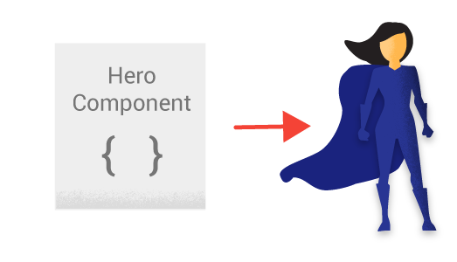
Component
app/hero-list.component.ts
export class HeroListComponent implements OnInit { heroes: Hero[]; selectedHero: Hero; constructor(private service: HeroService) { } ngOnInit() { this.heroes = this.service.getHeroes(); } selectHero(hero: Hero) { this.selectedHero = hero; } }

Slide 4
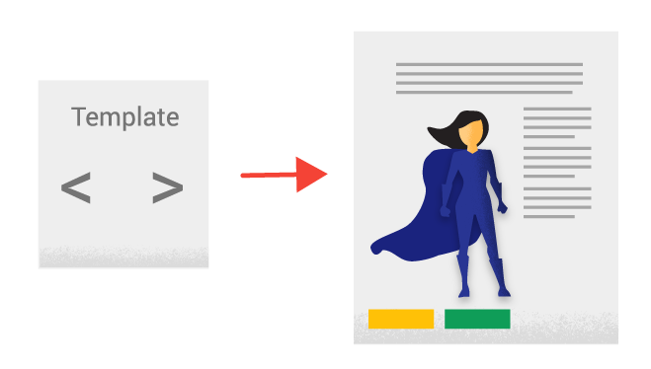
Template
app/hero-list.component.html
<h2>Hero List</h2>
<p><i>Pick a hero from the list</i></p>
<div *ngFor="let hero of heroes" (click)="selectHero(hero)”>
{{hero.name}}
</div>
<p>Selected hero: “{{selectedHero.name}}"</p>

Slide 5

@Component decorator
@Component({ selector: 'hero-list', templateUrl: 'app/hero-list.component.html'
})
export class HeroListComponent { ... }
selector - a css selector that tells Angular to create and insert an instance of this component where it finds a <hero-list> tag in parent HTML: <hero-list></hero-list>
Angular inserts an instance of the HeroListComponent view between tags.
templateUrl - the address of this component's template

Slide 6
Example: component
import {Component} from ’@angular/core';
@Component({ selector: 'my-app', template: ` <h1>{{title}}</h1> <h2>My favorite hero is: {{myHero}}</h2> ` }) export class AppComponent { title = 'Tour of Heroes'; myHero = 'Windstorm'; }
<body> <my-app>Loading...</my-app> </body>
index.html:

Slide 7
Example: create class for data and fill it
hero.ts:
export class Hero { constructor(public id:number, public name:string) { } }
app.component.ts:
@Component({ selector: 'my-app’,
templateUrl: 'app.component.html' })
export class AppComponent { title = 'Tour of Heroes'; heroes = [ new Hero(1, 'Windstorm'), new Hero(13, 'Bombasto'), new Hero(15, 'Magneta'), new Hero(20, 'Tornado') ]; myHero = this.heroes[0]; }

Slide 8
Example: show the list of heroes
Template app.component.html:
<h1>{{title}}</h1> <h2>My favorite hero is: {{myHero.name}}</h2> <p>Heroes:</p> <ul> <li *ngFor="let hero of heroes"> {{ hero.name }} </li> </ul> <p *ngIf="heroes.length > 3">There are many heroes!</p>

Slide 9
Example: work with the events
@Component({ selector: 'click-me', template: ` <button (click)="onClickMe()">Click me!</button> {{clickMessage}}` }) export class ClickMeComponent { clickMessage = ''; onClickMe() { this.clickMessage ='You are my hero!'; } }

Slide 10
Example: adding hero form
@Component({ selector: ‘add-hero', template: ` <input #newHero (keyup.enter)="addHero(newHero.value)" (blur)="addHero(newHero.value); newHero.value='' "> <button (click)=addHero(newHero.value)>Add</button>
<ul> <li *ngFor="let hero of heroes">{{hero}}</li> </ul>
`}) export class AddHeroComponent { heroes=['Windstorm', 'Bombasto', 'Magneta', 'Tornado']; addHero(newHero:string) { if (newHero) { this.heroes.push(newHero); } } }
Notes:
https://angular.io/docs/ts/latest/guide/user-input.html

Slide 11
Example: execute
main.ts
import {platformBrowserDynamic} from ' @angular/platform-browser-dynamic ' import {AppModule} from './app.component' const platform = platformBrowserDynamic();
platform.bootstrapModule(AppModule);
package.json
scripts
start: concurrently start TSC transpiler and server
necessary libraries: name, version
dependencies (SystemJS is used as module system)
devDependencies
tsconfig.json
TypeScript configuration
npm start

Slide 12

Thank you and have a great Angular 2 experience!

